Slide 1
CODING LABS
Customer Experience
Presented by Sarah Randolph, Head of Design

Slide 2
PHASEONE Stand alone experience
1
Notes:
Non platform - not logged in - add description - Non platform / External User Experience
Sarah to circle back on tabbed version / non authenticated ( as first described in phase 1 )

Slide 3
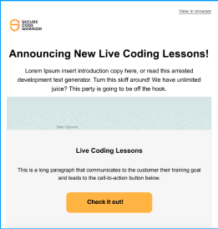
Unknown customer
Customer hears about Coding Labs
Via tweet
Via email
Via developer microsite
Notes:
from a link, a tweet, the developer microsite

Slide 4
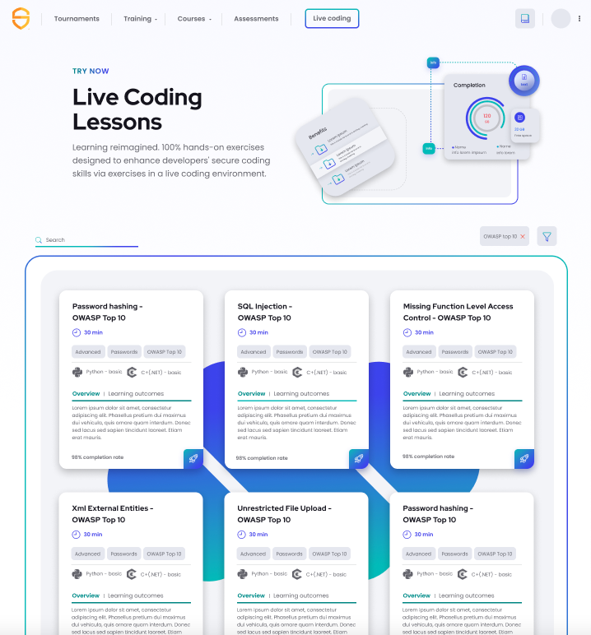
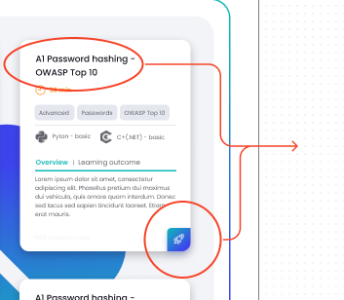
Landing Page
Customer arrives via link to landing page.

Slide 5
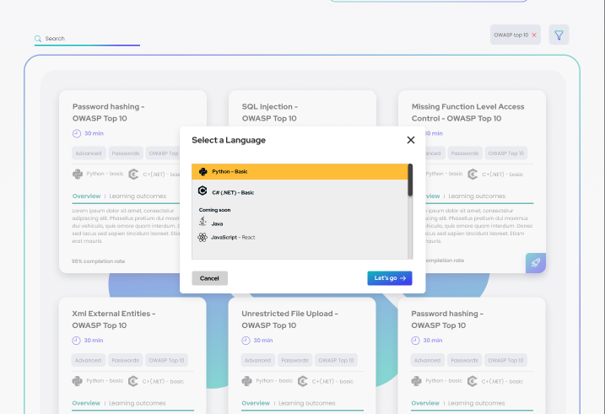
Select a Language
Customer selects lesson, and selects language.

Slide 6
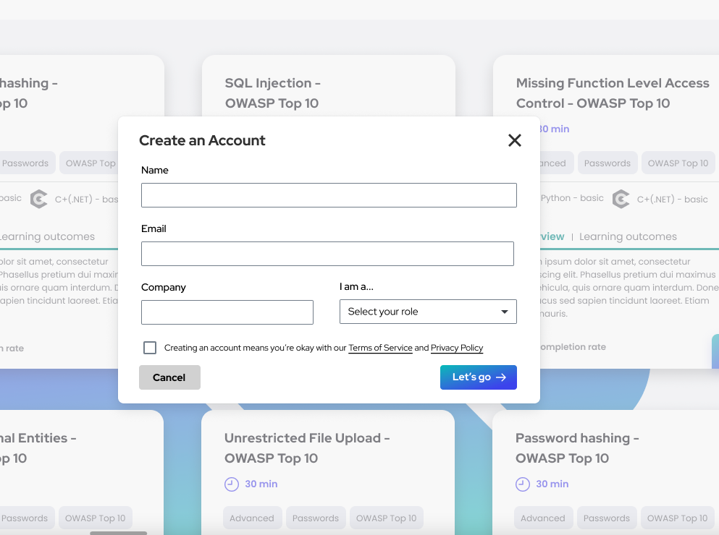
Optional create an account
Information we collect from free trial

Slide 7
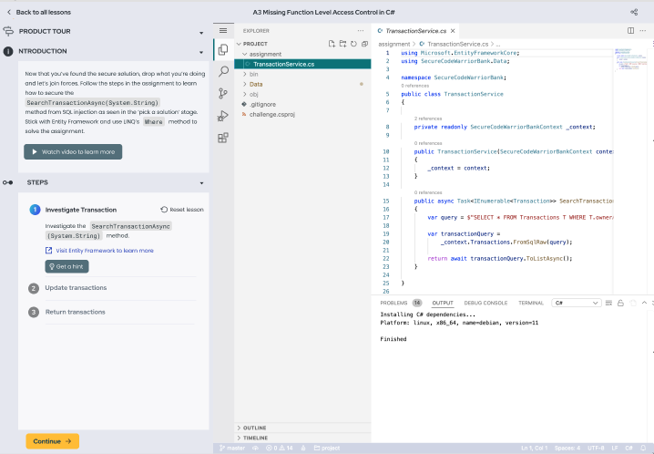
Introduction
Customer reads introduction message

Slide 8
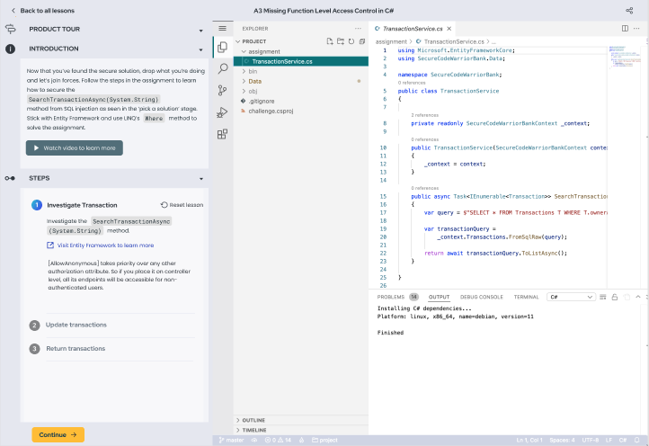
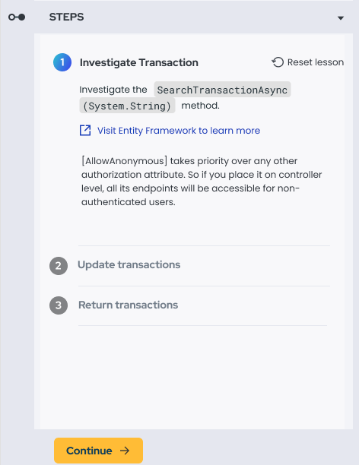
View Hint
Customer is able to view a hint.

Slide 9
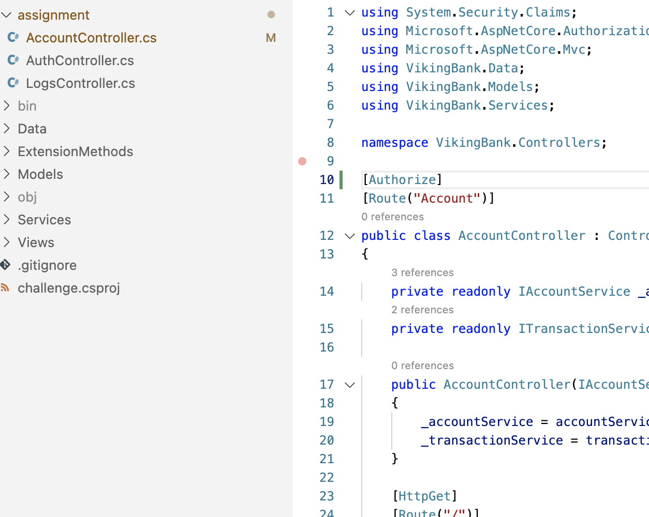
Enters Code
Customer enters code

Slide 10
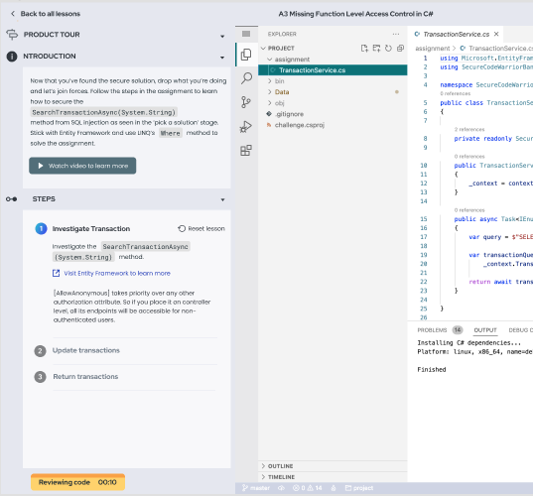
Reviewing Code
Reviewing Code button state change

Slide 11
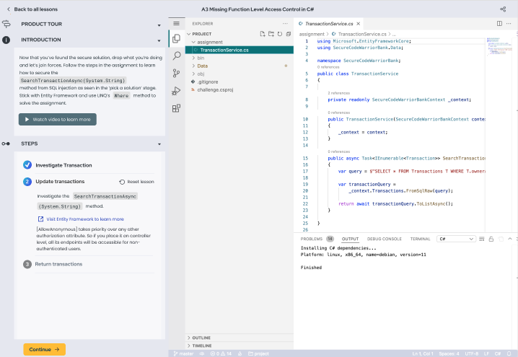
Step Complete
Customer completes a step, and moves to second step.

Slide 12
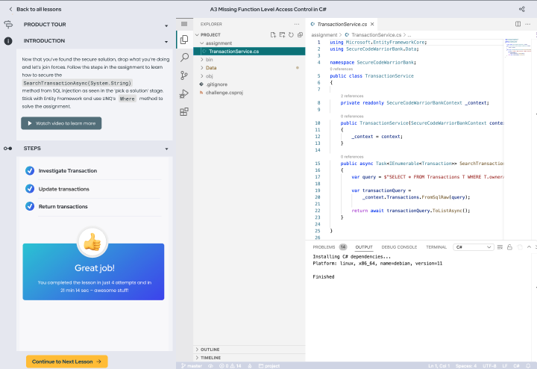
Lesson completed
Customer submits the correct answer, and has the option to move on immediately to the next language.

Slide 13
PHASE TWO
Existing Customer
2

Slide 14
Customer invite via email
Customer receives an invite via email

Slide 15
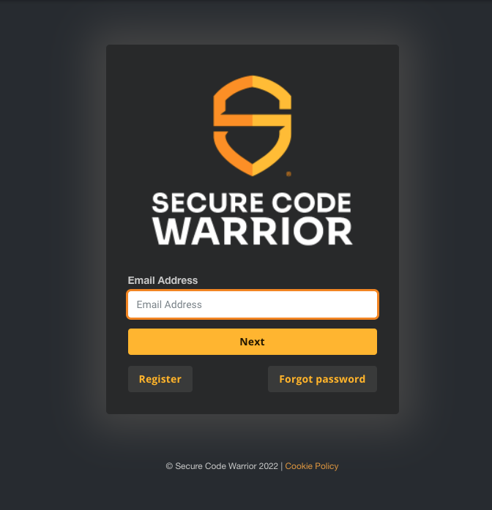
Log In
Customer is directed to a login screen

Slide 16
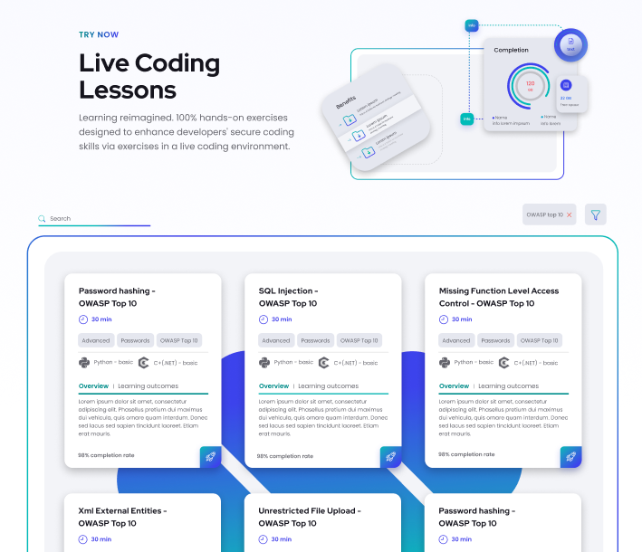
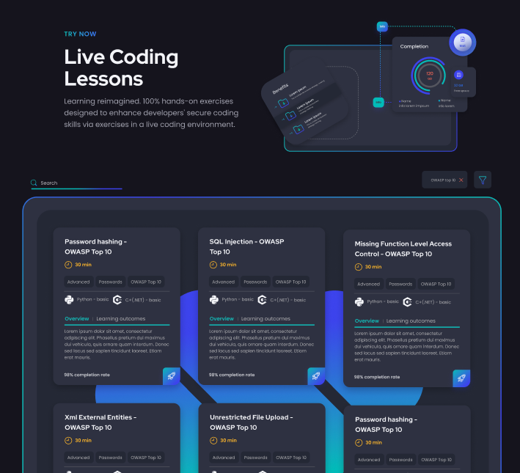
Landing Page
Customer is logged in and arrives at landing page

Slide 17
Landing Page
- Dark theme
Customer is logged in and arrives at landing page

Slide 18
Select a Language
Customer selects a language, and goes through the same phase as phase one, with the exception of logged in state.

Slide 19
Repeats LCL
Customer repeats challenge, and moves on to next lesson, or can go back to landing paged and browse the lessons.

Slide 20
PHASE THREE
Deep Course Integration
3

Slide 21
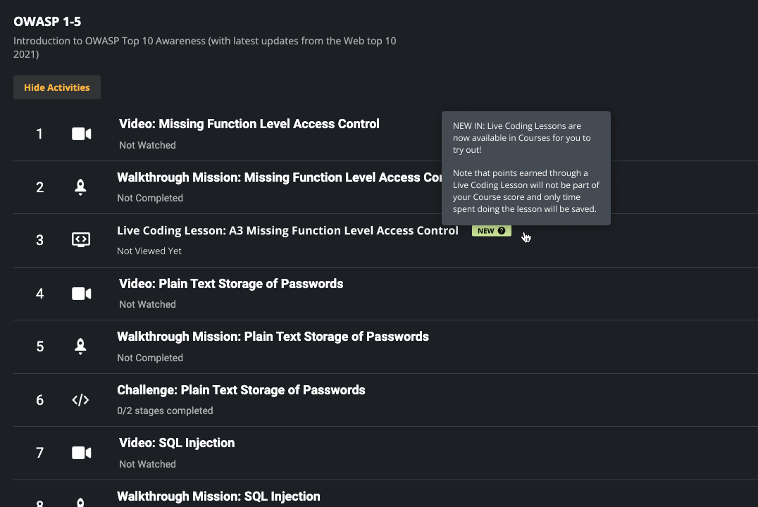
Customer arrives via course
Customer selects a live coding lesson from course

Slide 22
Repeat Live
Coding
Lessons
Customer repeats challenge, and moves on to next lesson, or can go back to landing page and browse the lessons.

Slide 23
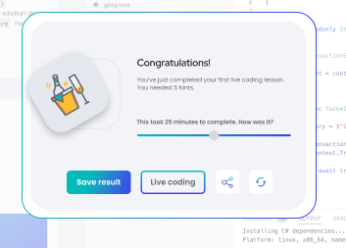
Survey
Customer
Notes:
The area where we’d like to collect feedback via userflow - trigger a userflow survey

Slide 24
Questions? Just Ask!

